Slide 1
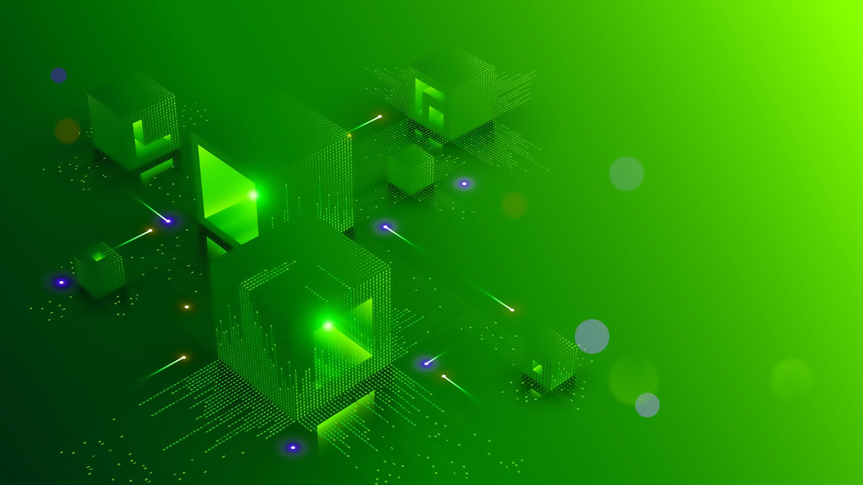
Motion Deblurring
Non-uniform deblurring for Shaken Images
Team – RC Squad

Slide 2
Objectives:
To implement parametrized geometric model of the blurring process in terms of the rotational velocity of the camera during exposure

Slide 3
Method Overview -
Blur from camera shake is mostly due to the 3D rotation of the camera, resulting in a blur kernel that can be significantly non-uniform across the image
We will apply this model to two different algorithms for camera shake removal: the first one uses a single blurry image (blind deblurring)
The second one uses both a blurry image and a sharp but noisy image of the same scene

Slide 4
Camera Shake Removal
We pre-process images with the commercially available PTLens tool, which uses a database of lens and camera parameters to correct for the distortion.

Slide 5


Timeline -
Mid Evaluation -
To recover an estimate f' of the true sharp image f.
Using Estimated kernel to deblur observed blur image directly, using the Richardson-Lucy (RL) algorithm, to give f'

Slide 6
THANK YOU

